Slide 1


Machine Learning Basics for Regression and Inference
Code and slides
URL: https://github.com/aidancrilly/ML_Lecture_Demos

Slide 2
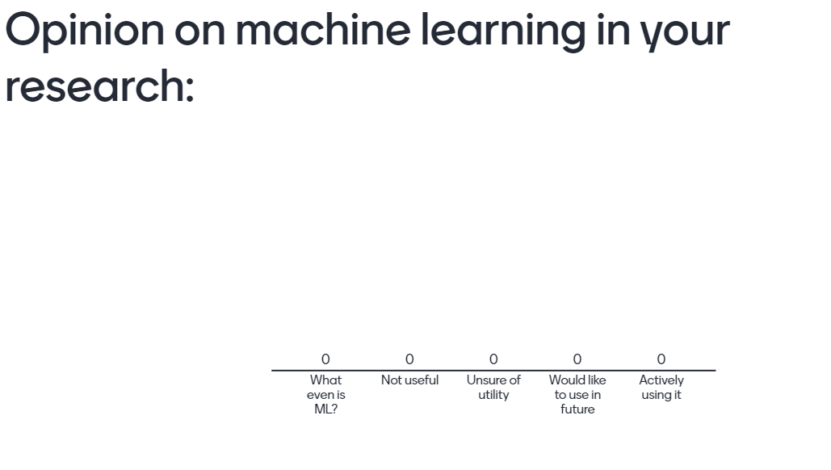
Go to menti.com and enter code 87 90 96 11

Slide 3
Machine Learning Basics for Regression and Inference
Dr Aidan Crilly
Schmidt AI in Science Postdoctoral Fellow

Slide 4
What to expect?
This talk aims to:
Introduce key machine learning (ML) concepts and language
Relate ML techniques to more familiar numerical methods
Introduce ML techniques which have been used in Plasma Group’s research
Hopefully, be a jumping off point to learning more about ML useful to your own research
This talk does not aim to:
Discuss ML research, we will discuss ML in research
Be an authority on ML, it would be great if this could become a discussion on use cases

Slide 5
Overview
What is Machine Learning?
Regression & Classification
Parametric Regressors (Non-neural)
Ordinary and Non-Linear Least Squares
Bayesian Inference
Non-Parametric Regressors
Gaussian Processes
Neural Networks

Slide 6
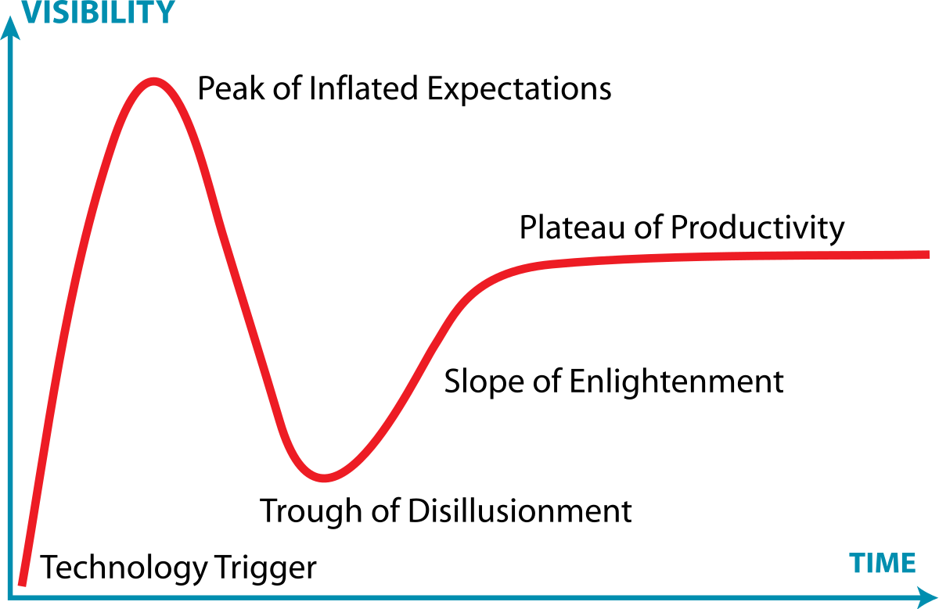
What is “Machine Learning”?
Numerical modelling which adapts parameters algorithmically to learn the relationship between input and output data
Parameter evolution often posed as an optimisation problem (nothing new!)
User often must select ‘hyper-parameters’ which change aspects of the machine learning algorithm

Slide 7

Regression & Classification
Two of the core ML tasks are regression and classification
Classification is the task of placing data within a finite number of sets, for example determining if a photo contains a cat or not
Regression is the task of estimating the functional relationship between a set of input and output variables, for example fitting a straight line to (x,y) data pairs

Slide 8
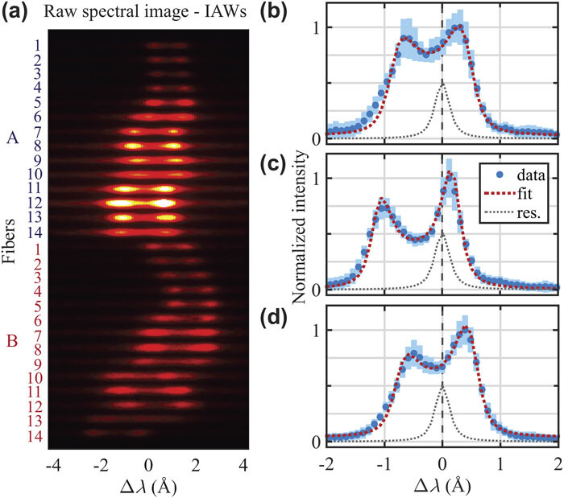
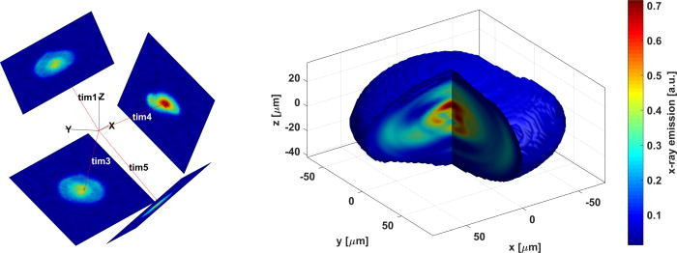
Regression
Regression problems are ubiquitous in data analysis within the physical sciences
An entirely non-exhaustive list of examples from my research:
Image reconstruction and 3D tomography
Thomson scattering spectra
Fusion neutron spectroscopy
X-ray line spectroscopy
Typically, reduced models with small number of parameters are used to fit each diagnostic signal separately
Latent parameters of numerical models can also be learned via regression

Slide 9
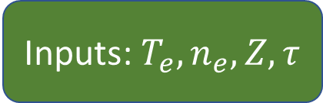
Parametric Regressors
The most common form of regression includes a ‘physics-based’ model which maps input physical parameters (e.g. temperature and density) to the expected diagnostic signature
For example, line spectroscopy
The ‘optimal’ set of parameters which match the observed data are sought in a forward-fit process
Inputs: $T_{e},n_{e},Z,τ$
Atomic Physics Model
Data-model consistency

Slide 10
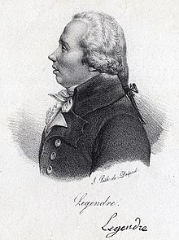
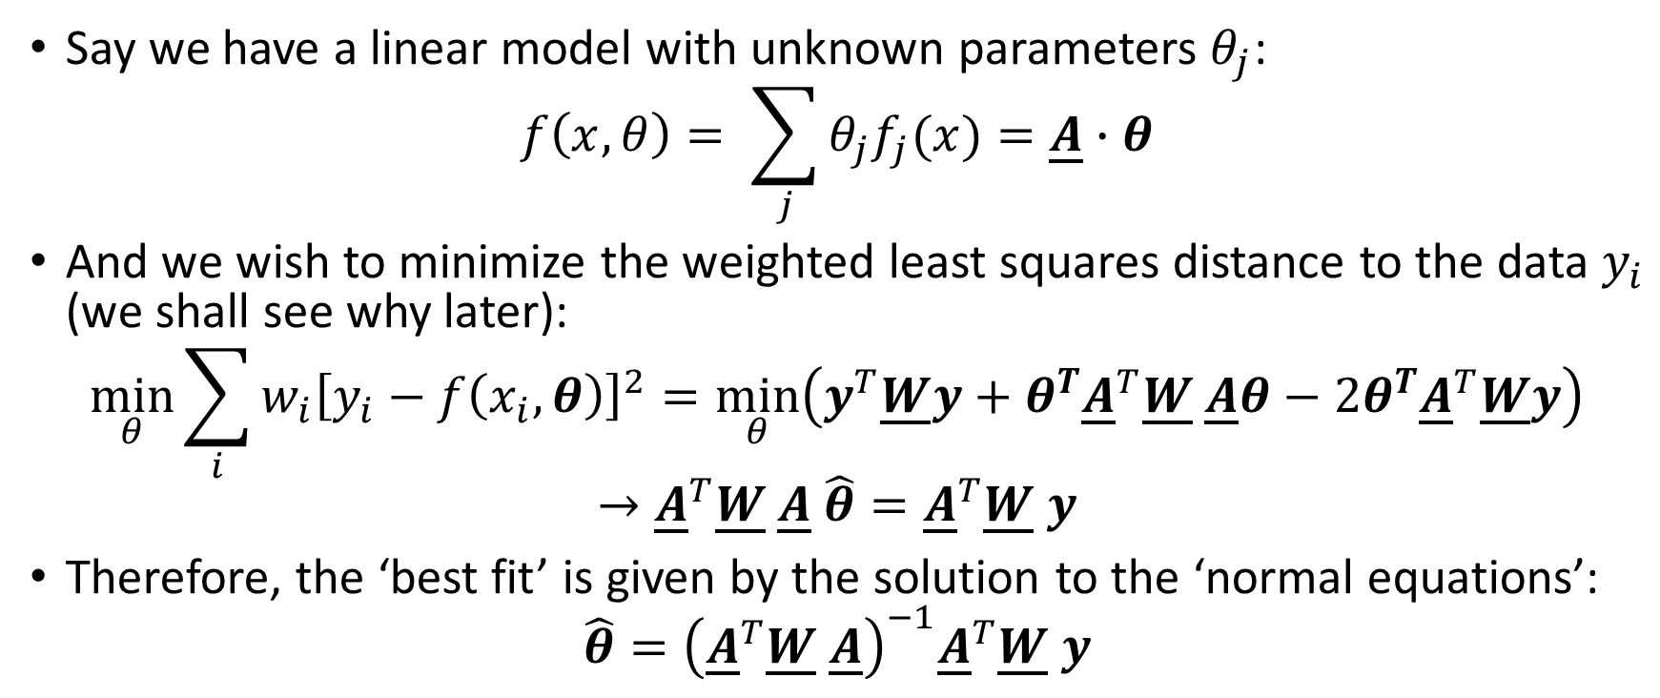
Ordinary Least Squares
Say we have a linear model with unknown parameters $θ_{j}$:
$$f\left(x,θ\right)= \sum_{j}{θ_{j}f_{j}(x)}=\underline{A}∙θ$$
And we wish to minimize the weighted least squares distance to the data $y_{i}$ (we shall see why later):
$$\min_{θ}{\sum_{i}{{w_{i}\left[y_{i}−f\left(x_{i},θ\right)\right]}^{2}}}=\min_{θ}\left(y^{T}\underline{W}y+θ^{T}{\underline{A}}^{T}\underline{W} \underline{A}θ−2θ^{T}{\underline{A}}^{T}\underline{W}y\right)$$
$$→{\underline{A}}^{T}\underline{W} \underline{A} \hat{θ}={\underline{A}}^{T}\underline{W} y$$
Therefore, the ‘best fit’ is given by the solution to the ‘normal equations’:
$$\hat{θ}={\left({\underline{A}}^{T}\underline{W} \underline{A}\right)}^{−1}{\underline{A}}^{T}\underline{W} y$$

Slide 11
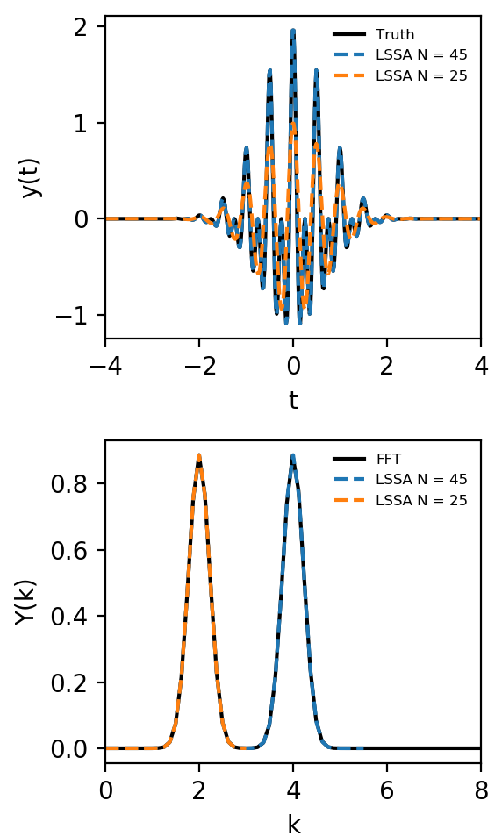

Practical example
Least-squares spectral analysis (LSSA) is a linear regression problem
Can handle unequally spaced data, uncertainties and limit the mode number
See Lomb-Scargle method
Not formally a Discrete Fourier Transform
$$f\left(x,θ\right)= \sum_{j=0}^{N}{θ_{j}\cos\left[\frac{πj}{T}t\right]}=\underline{A}∙θ$$
$$\hat{θ}={\left({\underline{A}}^{T} \underline{A}\right)}^{−1}{\underline{A}}^{T}y$$

Slide 12
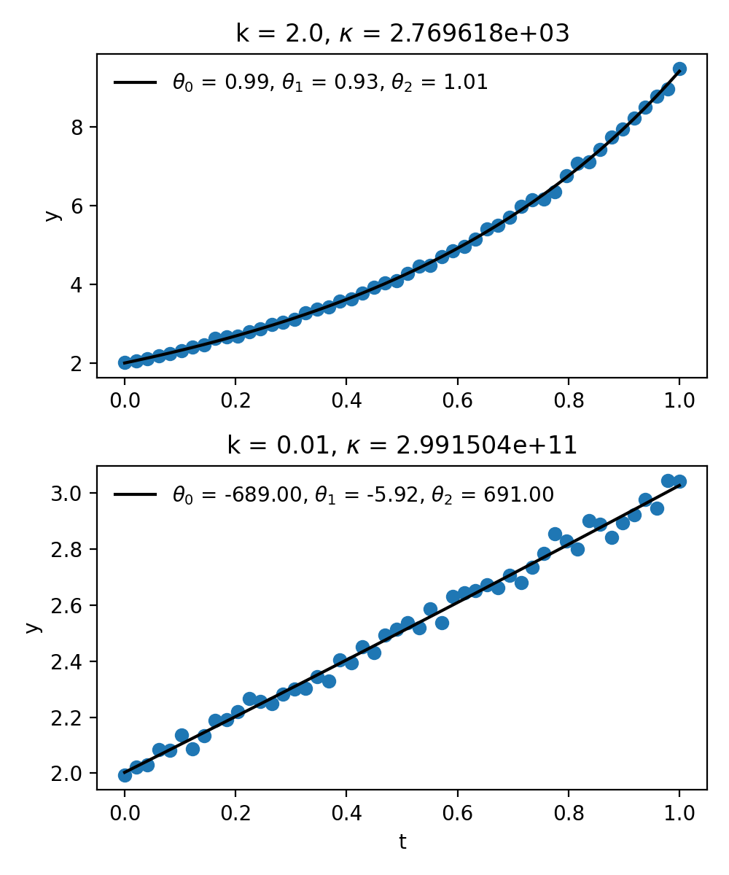
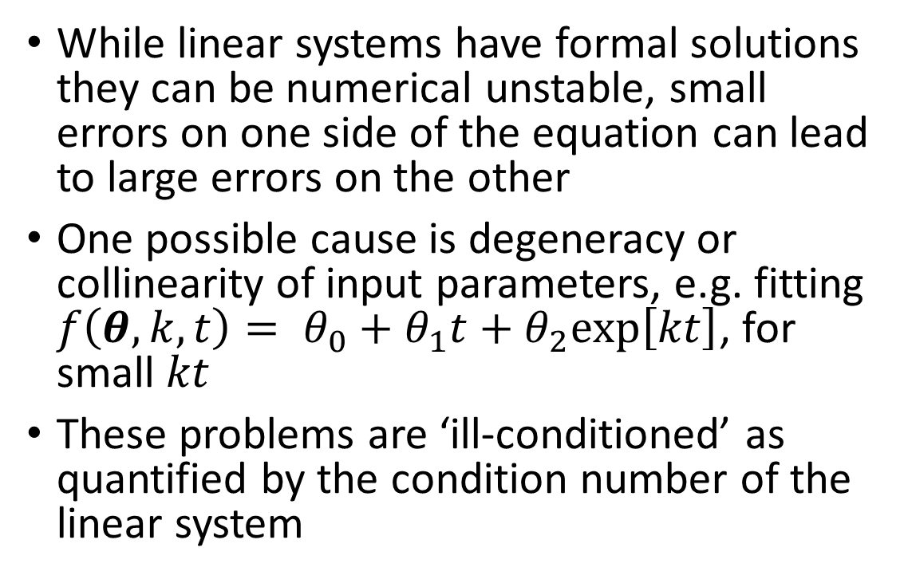
Ill-conditioned or ill-posed problems
While linear systems have formal solutions they can be numerical unstable, small errors on one side of the equation can lead to large errors on the other
One possible cause is degeneracy or collinearity of input parameters, e.g. fitting $f\left(θ,k,t\right)= θ_{0}+θ_{1}t+θ_{2}\text{exp}\left[kt\right]$, for small $kt$
These problems are ‘ill-conditioned’ as quantified by the condition number of the linear system

Slide 13
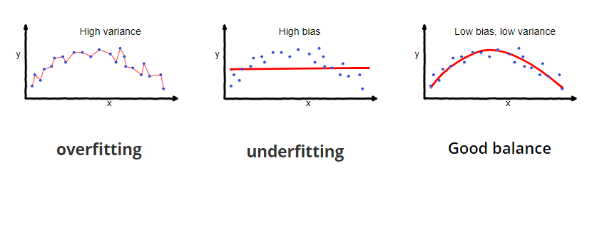
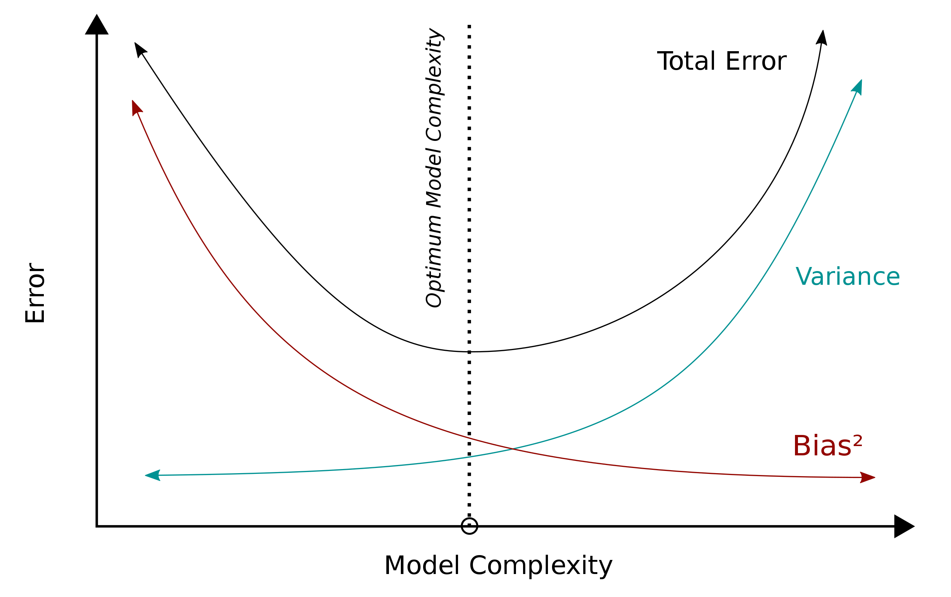
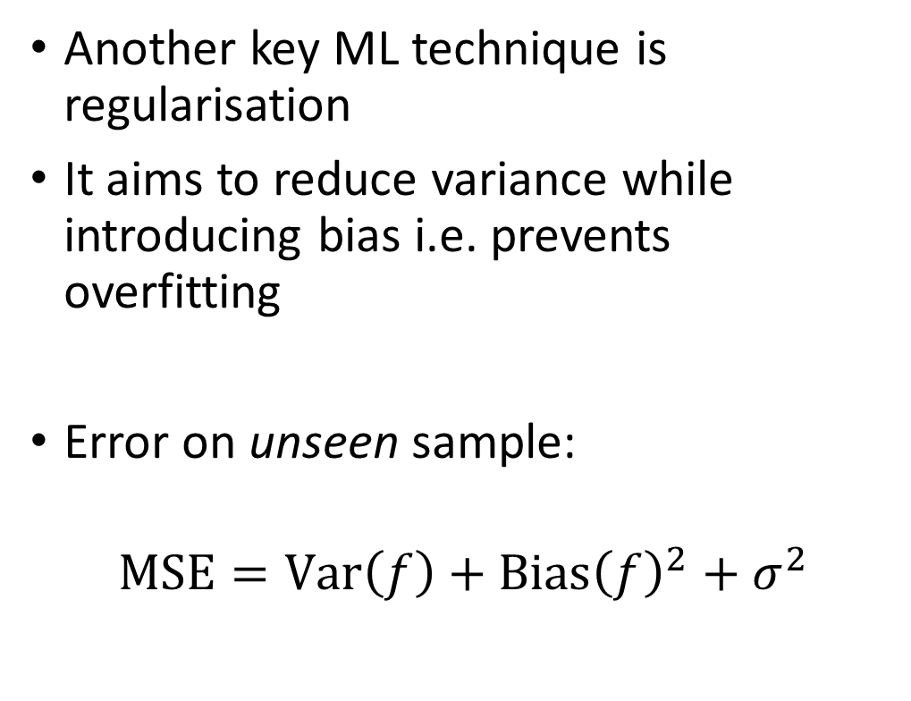
Regularisation – Bias-variance tradeoff
Another key ML technique is regularisation
It aims to reduce variance while introducing bias i.e. prevents overfitting
Error on unseen sample:
$$\text{MSE}=\text{Var}\left(f\right)+{\text{Bias}\left(f\right)}^{2}+σ^{2}$$

Slide 14
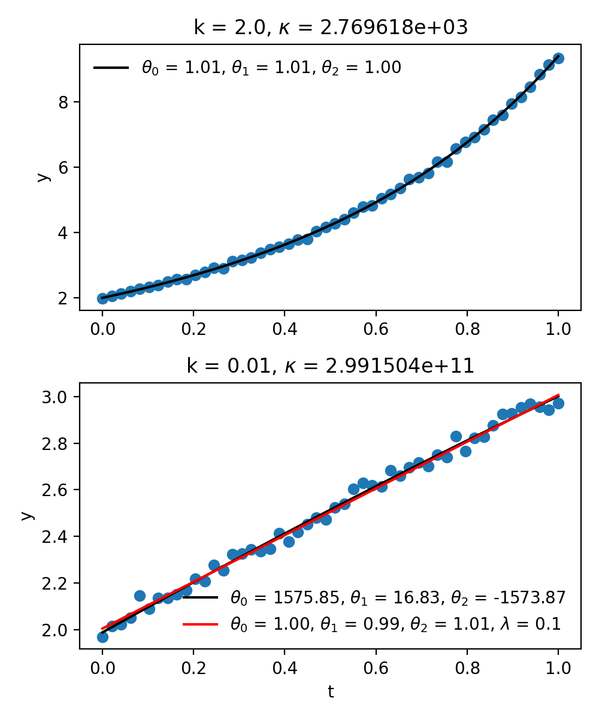
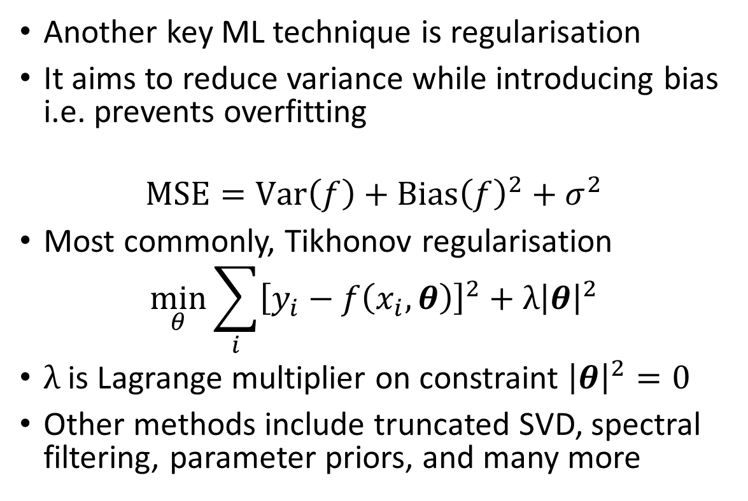
Regularisation
Another key ML technique is regularisation
It aims to reduce variance while introducing bias i.e. prevents overfitting
$$\text{MSE}=\text{Var}\left(f\right)+{\text{Bias}\left(f\right)}^{2}+σ^{2}$$
Most commonly, Tikhonov regularisation
$$\min_{θ}{\sum_{i}{{\left[y_{i}−f\left(x_{i},θ\right)\right]}^{2}}}+λ{\left|θ\right|}^{2}$$
$λ$ is Lagrange multiplier on constraint ${\left|θ\right|}^{2}=0$
Other methods include truncated SVD, spectral filtering, parameter priors, and many more

Slide 15
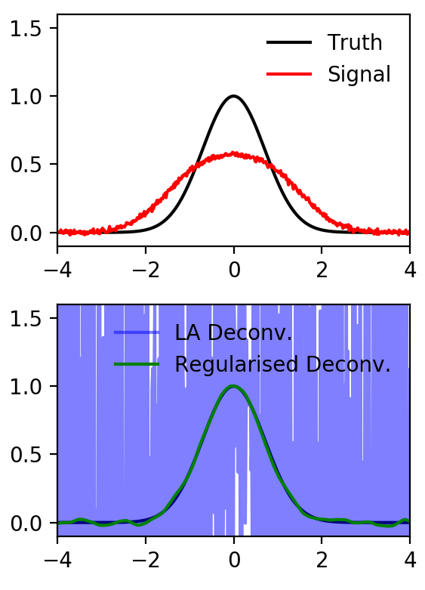
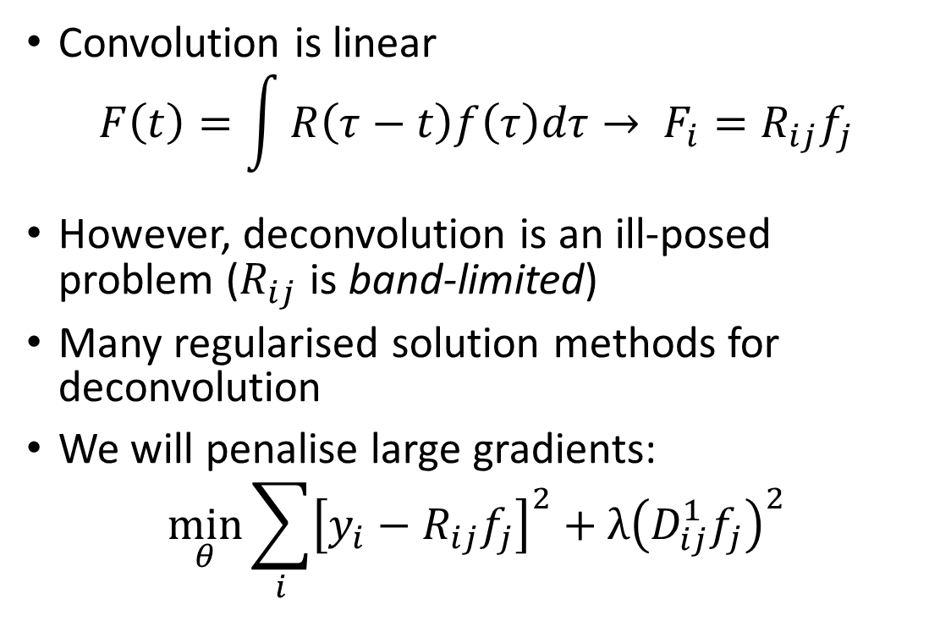
Deconvolution and Regularisation
Convolution is linear
$$F\left(t\right)=\int{R\left(τ−t\right)f\left(τ\right)dτ}→ F_{i}=R_{ij}f_{j}$$
However, deconvolution is an ill-posed problem ($R_{ij}$ is band-limited)
Many regularised solution methods for deconvolution
We will penalise large gradients:
$$\min_{θ}{\sum_{i}{{\left[y_{i}−R_{ij}f_{j}\right]}^{2}}}+λ{\left(D_{ij}^{1}f_{j}\right)}^{2}$$
First order finite difference

Slide 16
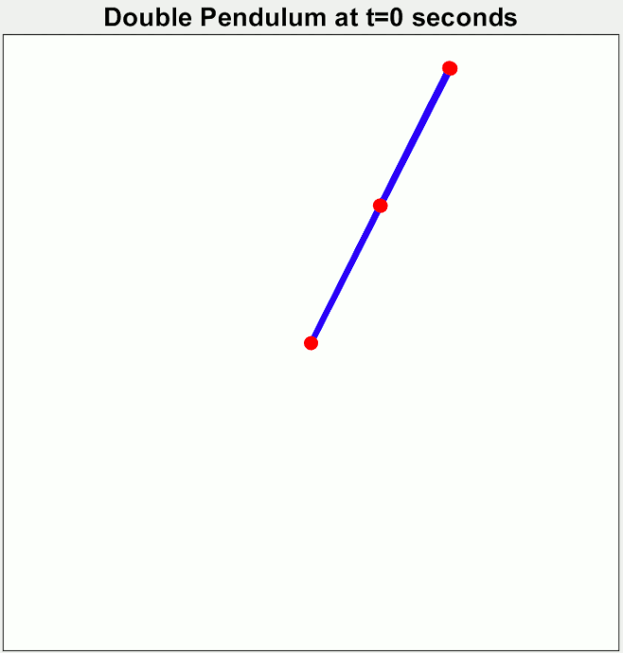
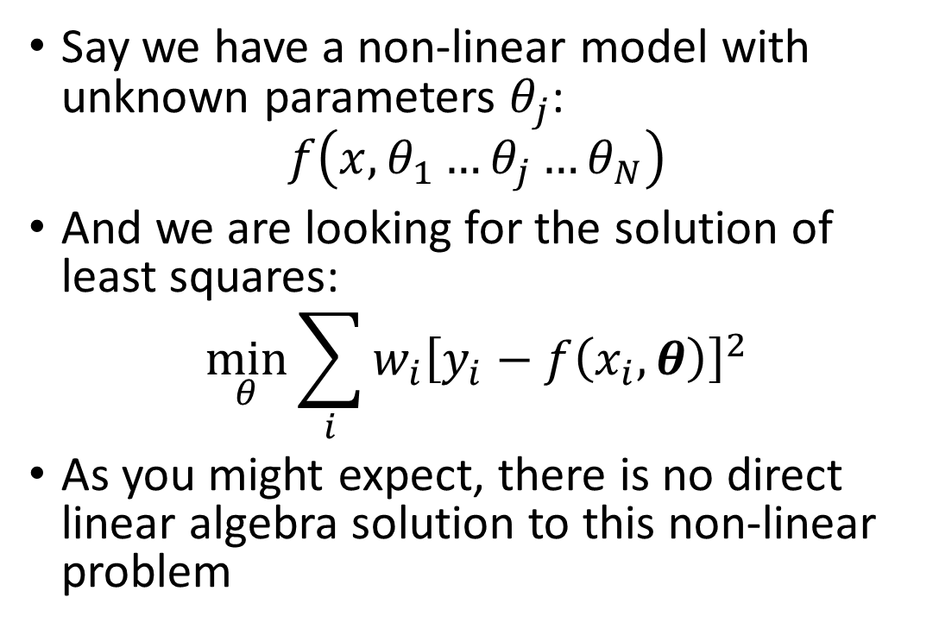
Non-Linear Least Squares
Say we have a non-linear model with unknown parameters $θ_{j}$:
$$f\left(x,θ_{1}…θ_{j}…θ_{N}\right)$$
And we are looking for the solution of least squares:
$$\min_{θ}{\sum_{i}{{w_{i}\left[y_{i}−f\left(x_{i},θ\right)\right]}^{2}}}$$
As you might expect, there is no direct linear algebra solution to this non-linear problem

Slide 17
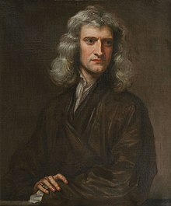
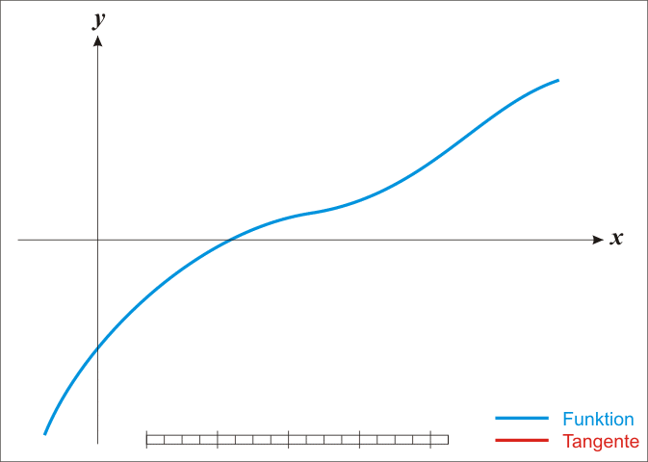
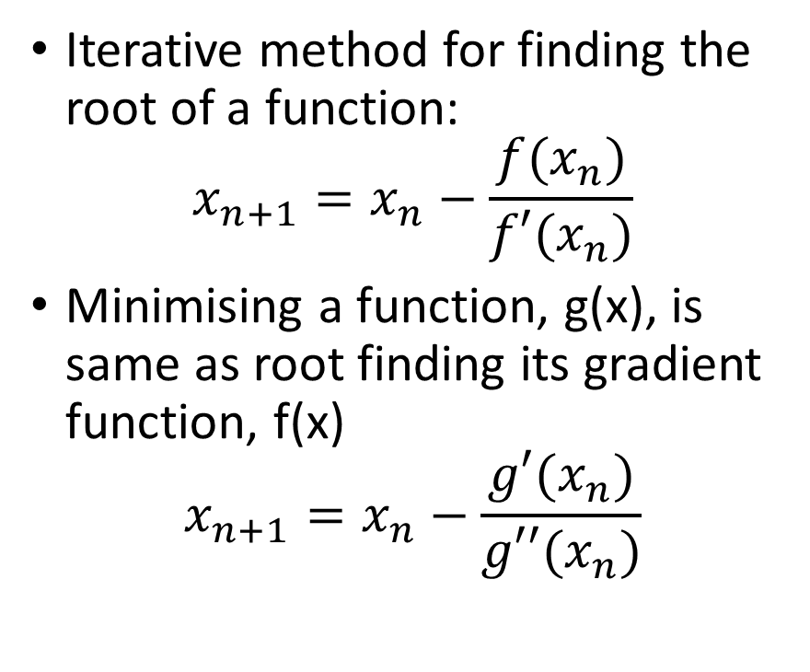
Reminder: Newton-Raphson Method
Iterative method for finding the root of a function:
$$x_{n+1}=x_{n}−\frac{f(x_{n})}{f′(x_{n})}$$
Minimising a function, g(x), is same as root finding its gradient function, f(x)
$$x_{n+1}=x_{n}−\frac{g′(x_{n})}{g′′(x_{n})}$$

Slide 18
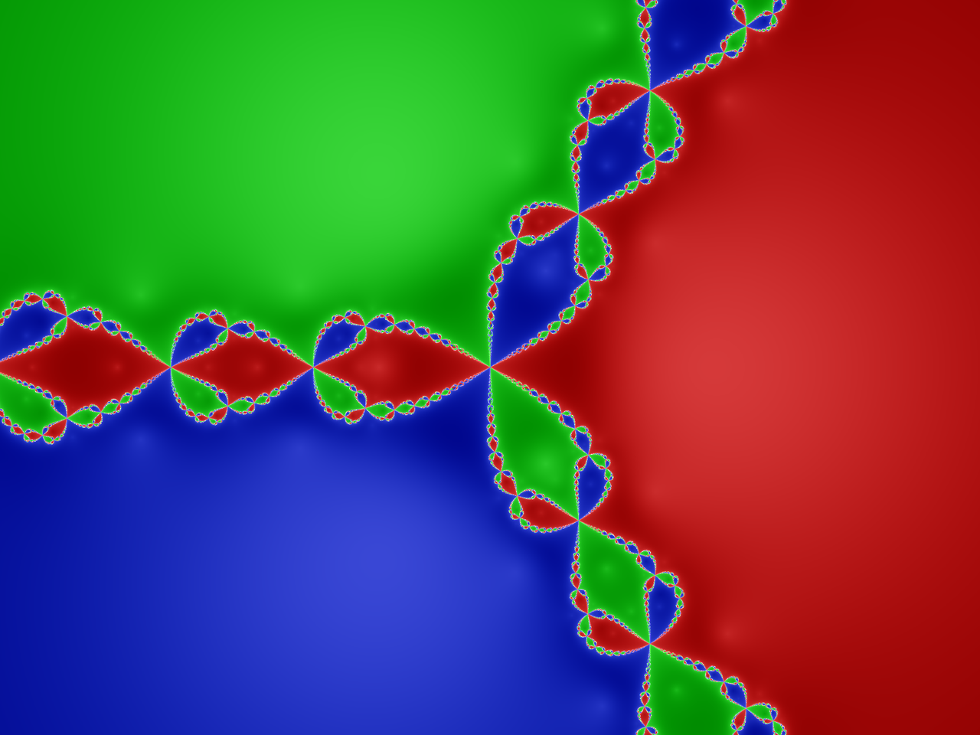
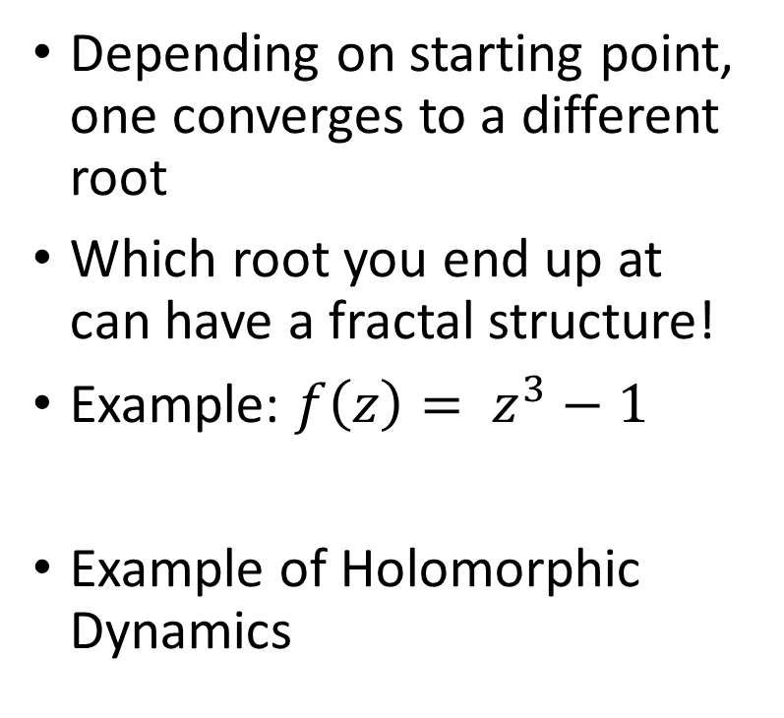
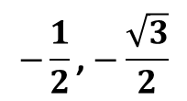
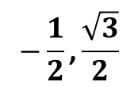
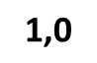
Fun aside: Newton’s Fractal
Depending on starting point, one converges to a different root
Which root you end up at can have a fractal structure!
Example: $f\left(z\right)= z^{3}−1$
Example of Holomorphic Dynamics
$$−\frac{1}{2}\text{,}\frac{\sqrt{3}}{2}$$
$$\text{1,0}$$
$$−\frac{1}{2}\text{,}−\frac{\sqrt{3}}{2}$$

Slide 19
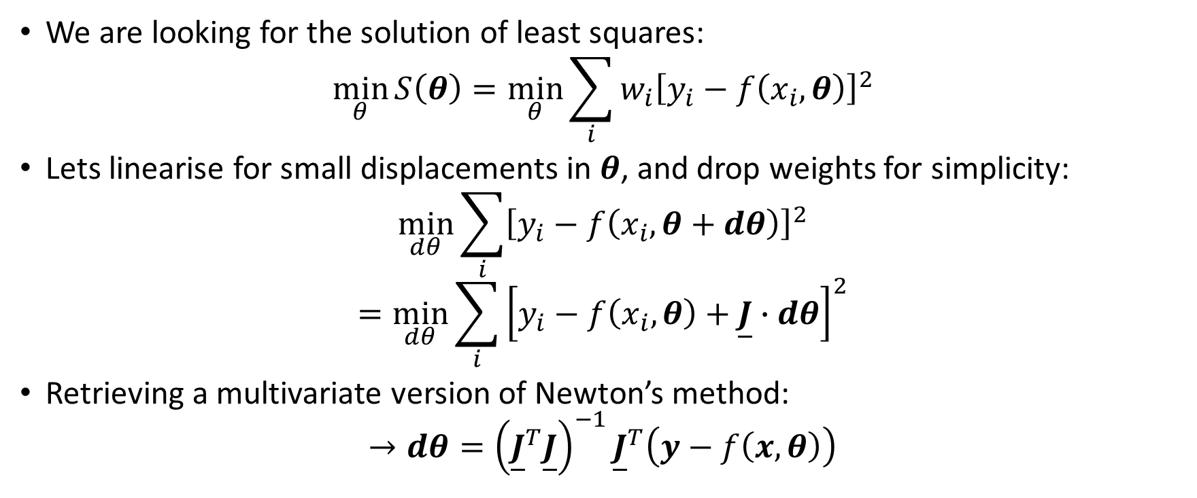
Non-Linear Least Squares
We are looking for the solution of least squares:
$$\min_{θ}{S\left(θ\right)=\min_{θ}\sum_{i}{{w_{i}\left[y_{i}−f\left(x_{i},θ\right)\right]}^{2}}}$$
Lets linearise for small displacements in $θ$, and drop weights for simplicity:
$$\min_{dθ}{\sum_{i}{{\left[y_{i}−f\left(x_{i},θ+dθ\right)\right]}^{2}}}$$
$$=\min_{dθ}{\sum_{i}{{\left[y_{i}−f\left(x_{i},θ\right)+\underline{J}∙dθ\right]}^{2}}}$$
Retrieving a multivariate version of Newton’s method:
$$→dθ={\left({\underline{J}}^{T}\underline{J}\right)}^{−1}{\underline{J}}^{T}\left(y−f\left(x,θ\right)\right)$$
N.B. we have approximated the Hessian as $2{\underline{J}}^{T}\underline{J}$, ignoring all 2nd derivatives, so we can get stuck in saddlepoints!

Slide 20
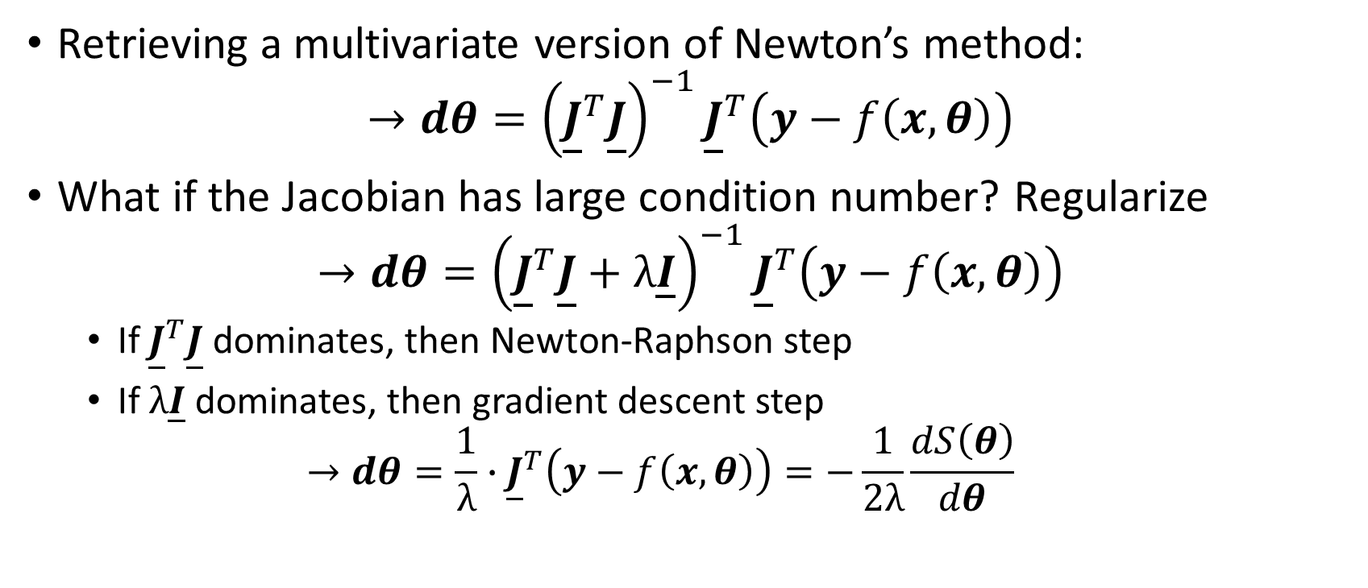
Non-Linear Least Squares
Retrieving a multivariate version of Newton’s method:
$$→dθ={\left({\underline{J}}^{T}\underline{J}\right)}^{−1}{\underline{J}}^{T}\left(y−f\left(x,θ\right)\right)$$
What if the Jacobian has large condition number? Regularize
$$→dθ={\left({\underline{J}}^{T}\underline{J}+λ\underline{I}\right)}^{−1}{\underline{J}}^{T}\left(y−f\left(x,θ\right)\right)$$
If ${\underline{J}}^{T}\underline{J}$ dominates, then Newton-Raphson step
If $λ\underline{I}$ dominates, then gradient descent step
$$→dθ=\frac{1}{λ}∙{\underline{J}}^{T}\left(y−f\left(x,θ\right)\right)=−\frac{1}{2λ}\frac{dS\left(θ\right)}{dθ}$$
N.B. Levenberg-Marquardt algorithm uses the above but adaptively changes $λ$, this is default algorithm in scipy.optimize.curve_fit

Slide 21
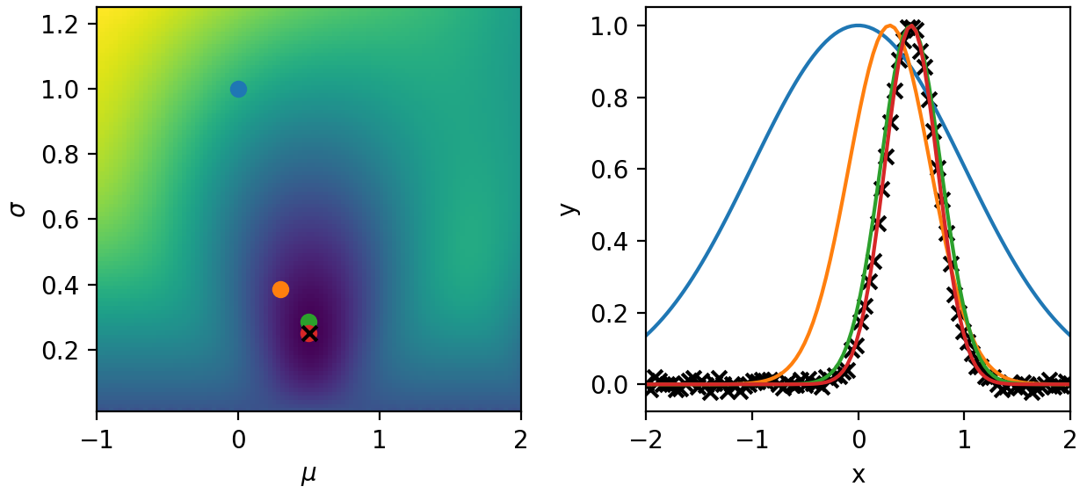

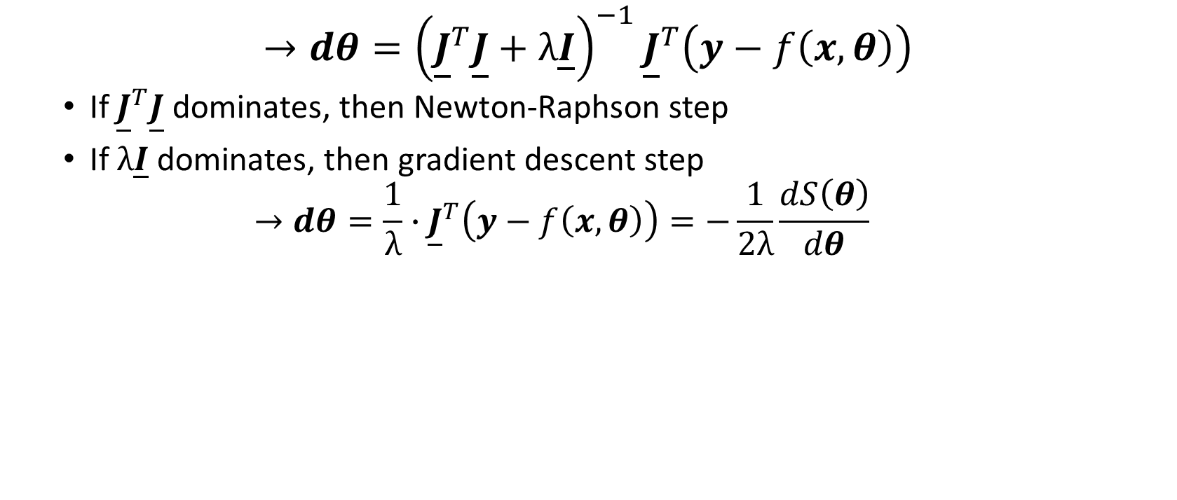
Non-Linear Least Squares
$$→dθ={\left({\underline{J}}^{T}\underline{J}+λ\underline{I}\right)}^{−1}{\underline{J}}^{T}\left(y−f\left(x,θ\right)\right)$$
If ${\underline{J}}^{T}\underline{J}$ dominates, then Newton-Raphson step
If $λ\underline{I}$ dominates, then gradient descent step
$$→dθ=\frac{1}{λ}∙{\underline{J}}^{T}\left(y−f\left(x,θ\right)\right)=−\frac{1}{2λ}\frac{dS\left(θ\right)}{dθ}$$
Newton-Raphson
Gradient Descent

Slide 22
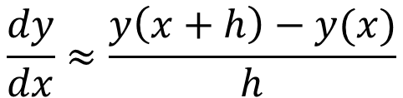
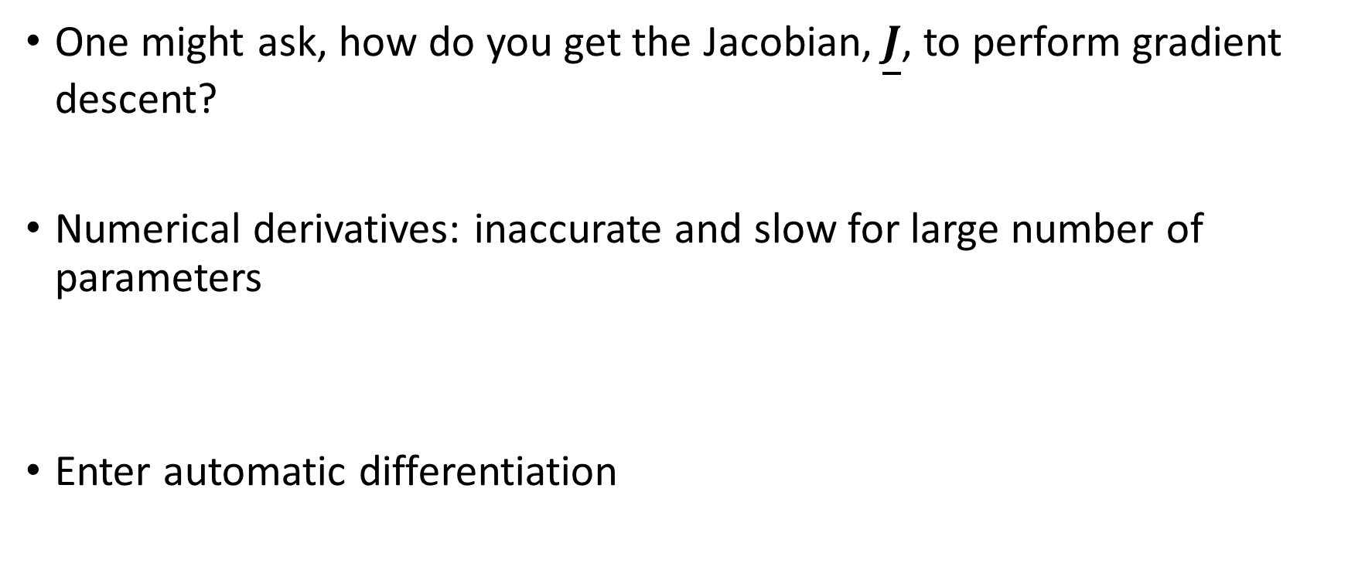
Differentiable Programming
One might ask, how do you get the Jacobian, $\underline{J}$, to perform gradient descent?
Numerical derivatives: inaccurate and slow for large number of parameters
Enter automatic differentiation
$$\frac{dy}{dx}≈\frac{y\left(x+h\right)−y(x)}{h}$$

Slide 23
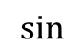


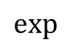

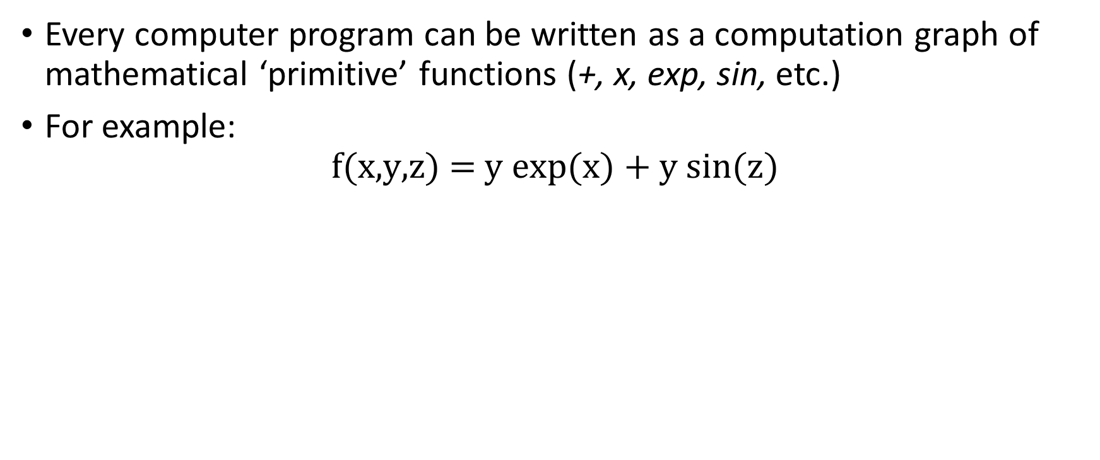
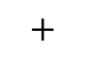





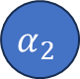


Automatic Differentiation Intro
Every computer program can be written as a computation graph of mathematical ‘primitive’ functions (+, x, exp, sin, etc.)
For example:
$$\text{f}\text{(}\text{x}\text{,}\text{y}\text{,}\text{z}\text{) = }\text{y} \text{exp}\text{(}\text{x}\text{) + }\text{y} \text{sin}\text{(}\text{z}\text{)}$$
x
$$α_{1}$$
$$\text{exp}$$
$$α_{4}$$
$$∗$$
$$α_{6}$$
$$+$$
y
$$α_{2}$$
$$α_{8}$$
$$f$$
$$∗$$
$$α_{7}$$
z
$$α_{3}$$
$$\text{sin}$$
$$α_{5}$$

Slide 24


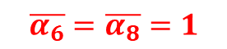

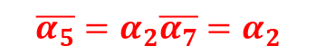
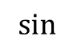

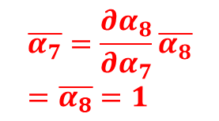

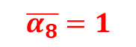
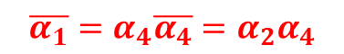
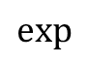

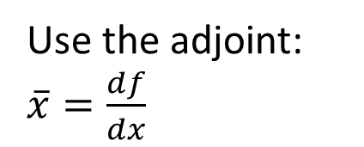

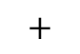

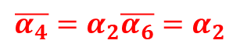



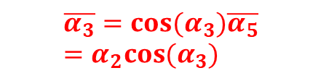
Automatic Differentiation Intro
In our example:
Use the adjoint: $\overline{x}=\frac{df}{dx}$
$$\overline{α_{1}}=α_{4}\overline{α_{4}}=α_{2}α_{4}$$
$$\overline{α_{4}}=α_{2}\overline{α_{6}}=α_{2}$$
x
$$α_{1}$$
$$\text{exp}$$
$$α_{4}$$
$$\overline{α_{6}}=\overline{α_{8}}=1$$
$$∗$$
$$\overline{α_{2}}=α_{4}\overline{α_{6}}+α_{5}\overline{α_{7}}=α_{4}+α_{5}$$
$$α_{6}$$
$$+$$
y
$$α_{2}$$
$$α_{8}$$
$$f$$
$$∗$$
$$α_{7}$$
$$\overline{α_{8}}=1$$
z
$$α_{3}$$
$$\text{sin}$$
$$α_{5}$$
$$\overline{α_{7}}=\frac{∂α_{8}}{∂α_{7}}\overline{α_{8}}=\overline{α_{8}}=1$$
$$\overline{α_{3}}=cos(α_{3})\overline{α_{5}}=α_{2}cos(α_{3})$$
$$\overline{α_{5}}=α_{2}\overline{α_{7}}=α_{2}$$
A single ‘back-propagation’ gives all gradients!

Slide 25
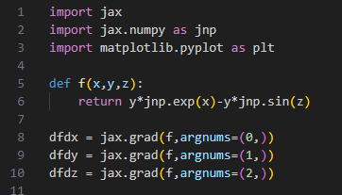















Automatic Differentiation Intro
In JAX:
In our example:
$$\overline{α_{1}}=α_{4}\overline{α_{4}}=α_{2}α_{4}$$
$$\overline{α_{4}}=α_{2}\overline{α_{6}}=α_{2}$$
x
$$α_{1}$$
$$\text{exp}$$
$$α_{4}$$
$$\overline{α_{6}}=\overline{α_{8}}=1$$
$$∗$$
$$\overline{α_{2}}=α_{4}\overline{α_{6}}+α_{5}\overline{α_{7}}=α_{4}+α_{5}$$
$$α_{6}$$
$$+$$
y
$$α_{2}$$
$$α_{8}$$
$$f$$
$$∗$$
$$α_{7}$$
$$\overline{α_{8}}=1$$
z
$$α_{3}$$
$$\text{sin}$$
$$α_{5}$$
$$\overline{α_{7}}=\frac{∂α_{8}}{∂α_{7}}\overline{α_{8}}=\overline{α_{8}}=1$$
$$\overline{α_{3}}=cos(α_{3})\overline{α_{5}}=α_{2}cos(α_{3})$$
$$\overline{α_{5}}=α_{2}\overline{α_{7}}=α_{2}$$
A single ‘back-propagation’ gives all gradients!

Slide 26


Automatic Differentiation Intro
Gradient descent using Automatic Differentiation (AD) gradients:
Need to:
Define ‘loss function’ $S\left(θ\right)$ which returns a scalar value given input parameters, $θ$
Using AD framework to compute $\frac{dS\left(θ\right)}{dθ}$ using AD
Set an initial value of $θ$
Identify a suitable learning rate – this can be found by checking that $S\left(θ\right)$ is decreasing after $θ$ is updated by $dθ$
$$dθ=\frac{1}{λ}∙{\underline{J}}^{T}\left(y−f\left(x,θ\right)\right)=−\frac{1}{2λ}\frac{dS\left(θ\right)}{dθ}$$
Other optimisers can use AD gradients, we shall cover them later

Slide 27
Using regression for inference
Finding the ‘best fit’ is an optimisation problem
In inference, we need additional information – the uncertainties

Slide 28




Bayes Theorem and Likelihoods
Bayes’ Theorem states:
Canonical example, medical testing:
Observations always have uncertainty, therefore Bayes rule must be used in parameter estimation
$$P\left(A | B\right)= \frac{P\left(B | A\right)P(A)}{P(B)}=\frac{\text{Likelihood} \text{x} \text{Prior}}{\text{Evidence}}$$
$$P\left(\text{ill} | +\right)= \frac{P\left(+ | \text{ill}\right)P(\text{ill})}{P(+)}=\frac{\text{Sensitivity} \text{x} \text{Prevalence}}{\text{True} \text{Positive}+\text{False} \text{Positive}}$$

Slide 29

Bayesian Inference
We wish to find the most likely physical parameters which describe the data:
P(model parameters given data): $P\left(θ | y\right)∝P\left(y | θ\right)P(θ)$
Define a likelihood that given the model, $f(θ,x)$, you would observe the data, say Gaussian errors:
$$P\left(θ | y\right)∝P(θ)\prod_{i}{\text{exp}\left(−\frac{{\left(y_{i}−f\left(x_{i},θ\right)\right)}^{2}}{2σ_{i}^{2}}\right)}$$
Take the logarithm to separate likelihood and priors
$$∝ \text{log}\text{(}P\left(y | θ\right)\text{) + }\text{log}\text{(}P(θ))=−\sum_{i}{{w_{i}\left[y_{i}−f\left(x_{i},θ\right)\right]}^{2}}+R(θ)$$
Least squares
Regularisation
Maximal posterior = Minimal least squares

Slide 30


Bayesian Inference – Laplace’s Method
Pierre-Simon Laplace
If we expand the log posterior about its optimum:
$$−\log\left(P\left(θ | y\right)\right)=F\left(θ\right)≈F\left(θ^{∗}\right)+J_{F}(θ) \left(θ−θ^{∗}\right)+\frac{1}{2}H_{F}(θ) {\left(θ−θ^{∗}\right)}^{2}$$
We see the posterior is locally a multi-variate normal:
$$P\left(θ | y\right)\sim exp⁡\left[−\frac{1}{2}H_{F}(θ) {\left(θ−θ^{∗}\right)}^{2}\right]$$
The Hessian gives us the covariance matrix – this is what scipy’s curve_fit is doing
0

Slide 31



Example in PythonJAX – Differentiable Programming
Following our non-linear least squares example, lets fit a Gaussian to data with uncertainties estimated using Laplace’s method
$$\underline{Σ}={\underline{H}}^{−1}$$

Slide 32



Bayesian Inference: Markov Chain Monte Carlo (MCMC)
We wish to find the posterior distribution of some parameters but we can only evaluate a function proportional to it (Likelihood x Prior)
70%
Markov chain:
A sequence of possible events where the next state only depends on the current state
Monte Carlo:
A class of numerical algorithm which involves repeated random sampling
70%
30%
10%
30%
90%
MCMC: Construct a Markov chain which has an equilibrium distribution of the posterior

Slide 33





Metropolis-Hastings* Algorithm
$P(x)$ is the probability distribution function we want to sample, $f\left(x\right)∝P(x)$:
Starting at $x_{i}$, randomly select a point $x^{∗}$ using jumping function $J(x^{∗}|x_{i})$
Compute the acceptance ratio, $α=f(x^{∗})/f(x_{i})$ and a random number $u∈[0,1]$
If $u ≤ α$, accept $x^{∗}→x_{i+1}$
Else, reject and $x_{i}→x_{i+1}$
* Arguably, the Rosenbluth algorithm

Slide 34

MCMC in practice
Burn in period
Good packages: PyMC, emcee
Define your log probability
Run # walkers for sampling
Inspect chains and auto-correlation time
Chop and thin chain for analysis

Slide 35
BREAK

Slide 36


Non-Parametric Regressors
In the absence of a parametric model, one might want a generic fitting model
Increasing in various levels of complexity:
Nearest-neighbour interpolation
Splines
Gaussian processes
Fitting function modifies as you introduce more data? That’s a nonparametric regressor
Spline fits are linear least squares:
$$f\left(x\right)= \sum_{i}{a_{i}B(x_{i},x)}$$
Given data, construct $B_{ij}$ at points $x_{j}$
Optimal amplitudes then:
$$\hat{a}={\left({\underline{B}}^{T} \underline{B}\right)}^{−1}{\underline{B}}^{T} y$$

Slide 37


Conditioning multivariate normals
We wish the predict the random variable $Y_{0}$ given data $Y_{n}$, these will be correlated
Assume joint distribution of prediction + data is multivariate normal:
$$\left(\begin{matrix}Y_{0} \\ Y_{n}\end{matrix}\right)\sim N_{1+n}\left[\begin{matrix}μ_{0} \\ μ_{n}\end{matrix},σ^{2}\left(\begin{matrix}R_{11} & R_{12} \\ R_{21} & R_{22}\end{matrix}\right)\right]$$
Conditional distribution of known data has mean and covariance matrix given by:
$$E\left(Y_{0}\right)=μ_{0}+R_{12}R_{22}^{−1}(Y_{n}−μ_{n})$$
$$Var\left(Y_{0}\right)=σ^{2}(R_{11}−R_{12}R_{22}^{−1}R_{21})$$
For more detail see: The Design and Analysis of Computer Experiments by Santner, Williams and Notz

Slide 38





Gaussian Processes
$$\underline{Σ}=σ^{2}\left[\begin{matrix}\begin{matrix}R(x_{0}−x_{0}) & R(x_{1}−x_{0}) \\ R(x_{0}−x_{1}) & R(x_{1}−x_{1})\end{matrix} & \begin{matrix}⋯ & R(x_{N}−x_{0}) \\ ⋯ & R(x_{N}−x_{1})\end{matrix} \\ \begin{matrix}⋮ & ⋮ \\ R(x_{0}−x_{N}) & R(x_{1}−x_{N})\end{matrix} & \begin{matrix}⋱ & ⋮ \\ ⋯ & R(x_{N}−x_{N})\end{matrix}\end{matrix}\right]$$
Gaussian processes use the conditional distribution to predict unobserved points
Mean function (usually 0) is linear fitting function, $μ\left(x\right)=\sum_{i}{θ_{i}f_{i}(x)}$
Correlation matrix defined by ‘kernel’ function $R\left(d\right)$
$$Y\left(x\right)= μ\left(x\right)+Z(μ=0,R\left(d\right))$$
Correlation function quantifies how correlated points in space are
How do you pick kernel free parameters…
$$E\left(Y_{0}\right)=R_{12}R_{22}^{−1}Y_{n}$$
$$R\left(d,l\right)=\text{exp}\left[−\frac{1}{2}{\left(\frac{d}{l}\right)}^{2}\right]$$

Slide 39


Gaussian Processes: Example
Kernel parameters found by maximal likelihood estimation given known data
Python libraries: Gpy, sklearn

Slide 40

Using Gaussian Process: Bayesian Optimisation
One canonical use of Gaussian Processes (GP) is in Bayesian optimisation:
From sample points train GP
Optimise an ‘acquisition function’ to find next sample point
Return to step 1 until global optimum found
See BayesianOptimisationDemo.py in shared code

Slide 41

Using Gaussian Process: Bayesian Optimisation
In practice:
Can be used to optimise expensive simulations
Usually start with a number of pseudo-random samples before training GP and starting BO

Slide 42







Neural Networks
Neural networks are the canonical AI model
They are black-box functions with many, many learnable parameters, ChatGPT 175 billion
Many flavours, we will discuss the multi-layer perceptron (MLP)
Basic unit is the neuron:
Neuron properties: Parameters: weight $w$, bias $b$
Activation function: tanh, ReLU, etc.
Input: $x$
Output: $y$
$$x^{′}= wx+b$$
$$y$$

Slide 43






Multi-Layer Perceptron
Stack neurons into layers and fully-connect layers
Define loss function between predicted and real outputs e.g. mean-squared-error (MSE)
Update neuron parameters by gradient descent (or variations of it)
It is just regularised non-linear least squares again!
$$dθ=α∙{\underline{J}}^{T}\left(y−f\left(x,θ\right)\right)$$
Rosenblatt with the Mark 1 Perceptron
Various optimisers
Loss
$$θ_{2}$$
$$θ_{1}$$
Learning rate
Jacobian found by AD
Neural network

Slide 44


Loss terms for neural networks
The most common are ‘prediction metrics’ such as mean squared error
Regularisers on weights and biases, common example is ‘L2-norm’ which is the same as Tikhonov, $λ{\left|θ\right|}^{2}$
$λ$ is now hyper-parameter like learning rate, $α$
More exotic terms are being introduced, like physics informed neural networks
AD allows derivative terms to be added to the loss

Slide 45



Neural Networks: Example
Learn relationship between Si IAW Thomson scattering features and physical parameters
$$θ=(n_{e},μ,T_{e},T_{i},Z,v_{fi},v_{fe})$$
$$y=({∆λ}_{m},{∆λ}_{h}−{∆λ}_{l},a_{λ})$$
Selection of the NN architecture can be human judgement or algorithmic
Tweaking of model parameters becomes tweaking of hyper-parameters
Data ‘featurisation’ is often key in producing a good model
1,411 trainable parameters

Slide 46






Neural Networks: Example
Learn relationship between Si IAW Thomson scattering features and physical parameters
$$θ=(n_{e},μ,T_{e},T_{i},Z,v_{fi},v_{fe})$$
$$y=({∆λ}_{m},{∆λ}_{h}−{∆λ}_{l},a_{λ})$$
Deep learning libraries: keras/tensorflow, sklearn, pytorch
$${∆λ}_{m}$$
$${∆λ}_{h}−{∆λ}_{l}$$
$$a_{λ}$$
https://gb.coursera.org/learn/neural-networks-deep-learning

Slide 47



Neural Networks: Example
Learn relationship between Si IAW Thomson scattering features and physical parameters
$$θ=(n_{e},μ,T_{e},T_{i},Z,v_{fi},v_{fe})$$
$$y=({∆λ}_{m},{∆λ}_{h}−{∆λ}_{l},a_{λ})$$
Deep learning libraries: keras/tensorflow, sklearn, pytorch
$${∆λ}_{m}$$
$${∆λ}_{h}−{∆λ}_{l}$$
$$a_{λ}$$
https://gb.coursera.org/learn/neural-networks-deep-learning

Slide 48




Examples in the field
Surrogate model of secondaries in MagLIF
Transfer learning in ICF experiments
NLTE opacity emulators

Slide 49
Method/topic | Resource (Youtube, book, python library, course, etc.)
Machine Learning | https://github.com/josephmisiti/awesome-machine-learning - Curated list of ML resources SciKit-Learn (sklearn), pycaret package gives examples Scipy.optimize “Pattern Recognition and Machine Learning” book
Bayesian Statistics | “Statistical Rethinking” Youtube lecture series and book
Markov Chain Monte Carlo | PyMC, emcee
Gaussian Processes | GPy, GPyTorch, sklearn “Design and Analysis of Computer Experiments” book (WARNING: Mathsy)
Deep Learning | Andrew Ng’s Deep Learning specialisation on Coursera (Can be done for free within time window, otherwise monthly charge)
Neural Networks | Tensorflow, PyTorch, Keras
Differentiable Programming | JAX and associated libraries (diffrax, optax, …)
Optimisation | Convex Optimisation I and II, Stanford Engineering Everywhere
Software Engineering | Free O’Reilly access: https://www.oreilly.com/library-access/ - Python Cookbook Imperial’s ‘Essential Software Engineering for Researchers’ course (1 credit)

Slide 50
Technique | Pros | Cons
Traditional optimisation (e.g. least-squares with L-M) | Widely used and easy to start Low number of hyperparameters Familiar techniques | Cannot handle noisy data Often require known Jacobian for best performance Uncertainties use Laplace’s method Results depend on starting location Scales poorly Can require regularisation
Gradient free optimisation (e.g. Bayesian optimisation) | Finds global minimum No need for gradient information Can handle noisy data | Scales very poorly Choice of kernel (BO) Spend time exploring domain
Differentiable programming | Gradient information for any program Scales well Allows gradients to appear in loss function | Must write code in differentiable form – harder to debug
Splines, etc. | Flexible functions with local extent Data driven predictor | Often want model parameters not predictor function
Markov Chain Monte Carlo | Explore full posterior distribution Proper Bayesian treatment Does not require gradients (apart from HMCMC) | Large number of function evaluations needed
Gaussian processes | Like splines but with uncertainties | Scales poorly
Neural networks | Universal function approximators Scales very well Architectures adapted to problems e.g graphs for molecules | Requires large data set Large number of hyperparameters Model training can be expensive

Slide 51
Machine Learning in Plasma Group Research
Four examples of Plasma Group publications using ML:
“Using Differentiable Programming to Learn Closure Relations: An Example in Radiation Transport”
“Automation and control of laser wakefield accelerators using Bayesian optimization”
“Laser Wakefield Accelerator modelling with Variational Neural Networks”
These cover Differentiable Programming, Markov Chain Monte Carlo, Gaussian Processes, Neural Networks and optimisation techniques

Slide 52










Learning Closure Relations using Differentiable Programming: An Example in Radiation Transport (Crilly et al Accepted at NeurIPS ML 4 Physical Sciences Workshop 2023)
Open-source code
Can back-propagate gradients through solutions to PDEs
Numerical solutions to PDEs look like pre-trained recurrent graph neural networks
Allows closures to be learned from analytic test problems
Initial conditions
$$y_{0}$$
$$y_{1}$$
$$y_{2}$$
…
$$y_{N}$$
$$A_{0}$$
$$A_{1}$$
$$A_{2}$$
…
$$\text{ℒ}$$
Model parameters

Slide 53

Automation and control of laser wakefield accelerators using Bayesian optimization (Shalloo et al Nat. Comms 2020)
Uses Gaussian Process Regression to optimize some property of a laser wakefield accelerator
Experimental measurements are made at initial positions
GPR model updated with the measurements to form a posterior distribution.
An acquisition function is computed and used to select the next measurement location.
Steps 3–4 are repeated until the convergence criteria are met.
Acquisition function chosen to balance finding the optimum and exploring the function
4 laser parameters and 2 plasma parameters controlled to optimize the brightness of generated X-rays

Slide 54



Laser Wakefield Accelerator modelling with Variational Neural Networks (Streeter et al HEDP 2023)
LWFA spectra differ from shot-to-shot
In experiments that use the beam we would like to know the spectrum on each shot
But if the beam is used, can we use other diagnostics to work out what the beam was?
We trained a variational neural network based on three non-invasive diagnostics to see if this was feasible
Variational neural networks free parameters are random normal variables
E.g. Weight $w →(μ_{w},σ_{w})$
15 example predictions – compared to the actual measurement
Black: measured spectrum; Red: model prediction;
Blue: previous best estimate without using a NN

Slide 55
Additional learning oppurtunities
I am keen to:
Start a book club to focus more on deep learning – Bishop & Bishop
Give a 1-day short course on differentiable simulators (lunch provided)
Let me know if interested in either or both these ideas!

Slide 56

Links
Please give me some feedback to improve the course
Feedback
URL: https://forms.gle/37bDBPbWVufSjpB9A
Code and slides
URL: https://github.com/aidancrilly/ML_Lecture_Demos

